Slide 1
Chapter 8
Managing Files

Slide 2
Learning Objectives
Organize Files and Folders
Manage Files and Folders
Work with Compressed Files

Slide 3
Organizing Files and Folders
Topics Covered:
The Windows 7 File System
Developing an Organizational Strategy
Navigating to Files

Slide 4
The Windows 7 File System
To ensure system stability and to find files quickly, Windows 7 organizes the folders and files in a hierarchy, or file system.
The root directory is the first or top-most directory in a hierarchy. It can be likened to the root of a tree - the starting point where all branches originate.
On the C: drive at the top of the hierarchy is the root directory, where Windows 7 stores folder and files that it needs when you turn on the computer.
Some folder contain other folders, called subfolders.

Slide 5
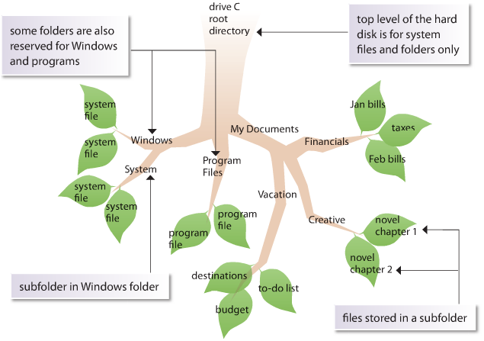
The Windows 7 File System

Slide 6
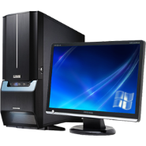



File Organization
Documents and other data
Windows
Programs
My Documents

Slide 7
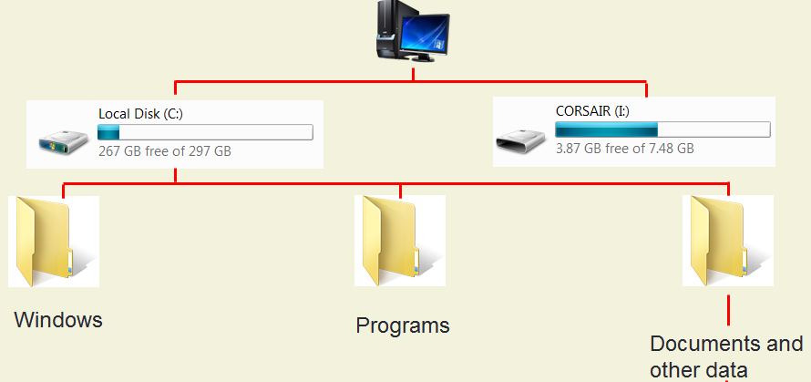

File Organization
My Documents
Basic Accounting
Computer Concepts
Computer Concepts
Memo
Policy
Proposal
Report

Slide 8
Developing an Organizational Strategy
It is important to develop a strategy for organizing your folders and files.

Slide 9

Navigating to Files
The file path shows the location of a file on a computer and leads you through the file and folder organization to the file.
This file path includes:
Drive name
Top-level folder
Subfolder
Full file name, including file extension

Slide 10
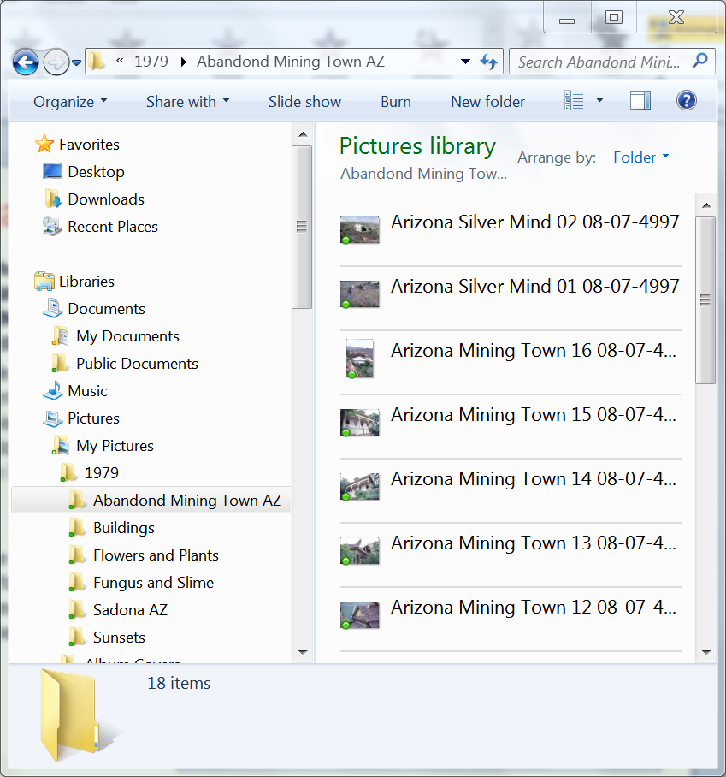
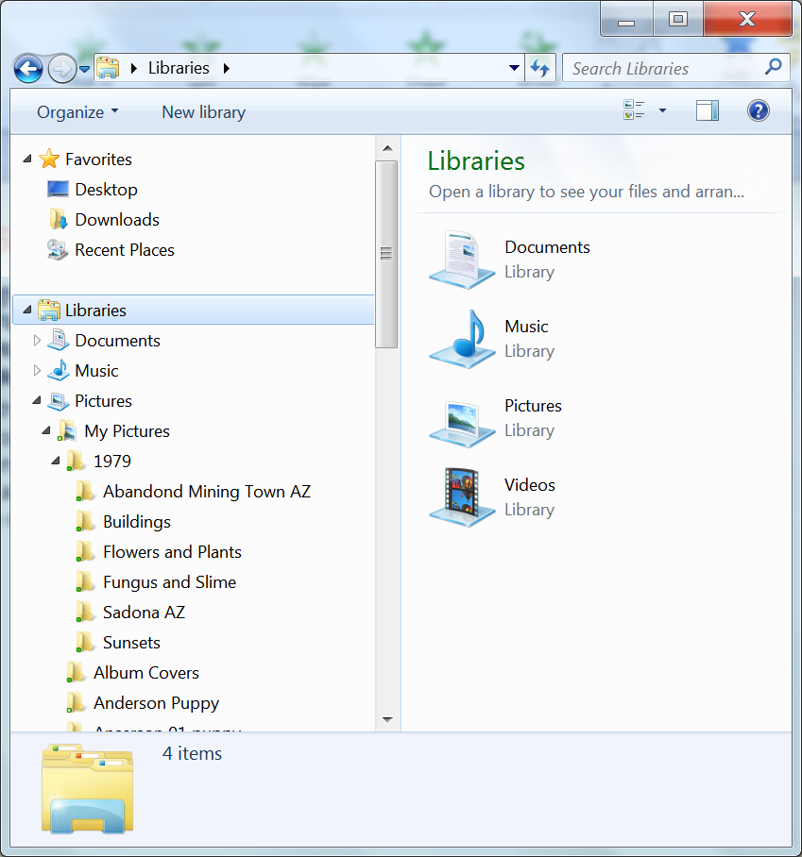
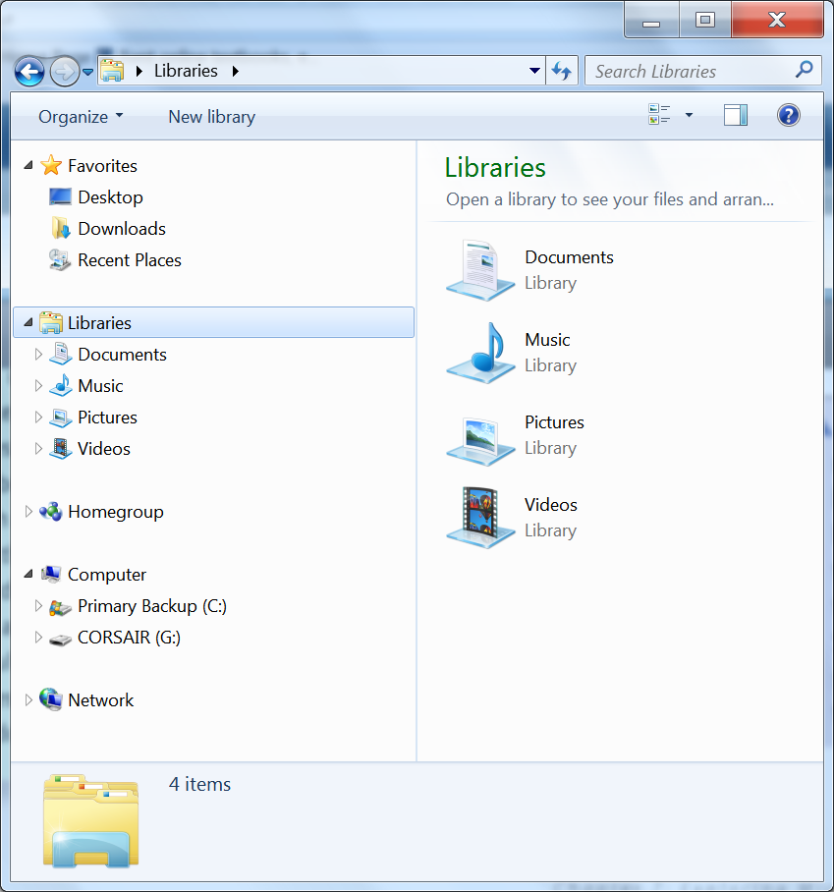
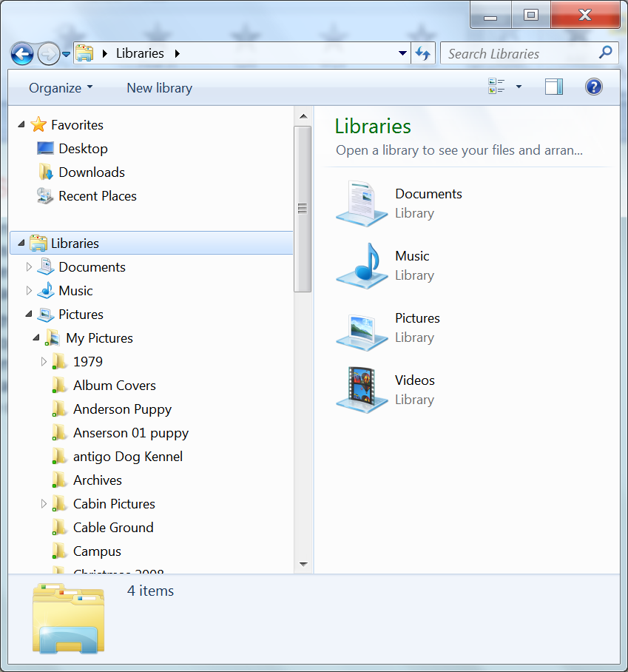
Navigating to Files
Currently we are looking at what is contained in the libraries folder. Notice that the triangle is pointing down
Clicking on the triangle in front of a library or folder will open that folder and display the folders inside. (subfolders)
Note that the libraries listed have open triangles in front of them. This indicated there are additional folders inside of the library.
Note that the folders inside of the 1979 folder do not have triangles, this indicates that this folder only contains files.
Clicking on a folder with no triangle will show the files that folder contains.

Slide 11
Managing Folders and Files
Topics Covered:
Creating a Folder or Subfolder
Moving or Copying Files and Folders
Naming and Renaming Files
Deleting Files and Folders

Slide 12
Creating a Folder or Subfolder
The first step is to determine which files seem to belong together.
Next, develop an appropriate file structure.
When you are working on your own computer, you usually create folders within the My Documents folder and other standard folders, such as My Music and My Pictures.

Slide 13
Guidelines for Creating Folders
Keep folder names short and familiar.
Develop standards for naming folders.
A folder name can have up to 255 characters, but cannot include the / \ : * ? “ < > or | characters.
Create subfolders to organize files.

Slide 14
Moving or Copying Files and Folders
Moving a file removes it from its current location and places it in a new location you specify.
Copying also places the file in a new location that you specify, but does not remove it from its current location.
To move or copy more than one file at the same time, you select all the files you want to copy, and then drag them as a group.
To select files that are adjacent in a window, click the first file in the list, hold down the Shift key, click the last file in the list, and then release the Shift key.
To select files that are not adjacent, click one file, hold down the Ctrl key, click the other files, and then release the Ctrl key.

Slide 15
Moving or Copying Files and Folders
Another way to move or copy files and folders is to use the clipboard, a temporary storage area in Windows on which objects are stored when you copy or move them.
To use the Clipboard,
Cutting (moving) - right-click a file or folder, and then on the shortcut menu, click Cut to remove the file or folder from its current location
Copying right-click a file or folder, and then on the shortcut menu, click Copy to duplicate the file or folder on the Clipboard, leaving the original in its original location.
To paste the contents of the Clipboard, right-click a blank area of the folder window in which you want to put the moved or copied file or folder, and then on the shortcut menu, click Paste.

Slide 16
Moving or Copying Files and Folders
Dragging a file and folder using the right mouse button.
To use this method,
Right click an hold down the right mouse button
Drag the file or folder to the location where you wand to move or copy the item
Release the right mouse button and from the list that appears select either copy here or move here.
Do not select create a short cut.

Slide 17
Naming and Renaming Files
Three parts of a filename:
Main part
Dot
File extension
Filenames cannot contain the \ / ? : * “ <> | symbols

Slide 18

File Extensions
File extensions indicate the application that created the file.
.docx
.pptx
.xlrx.
File extensions are not always visible.
You can also tell the program that created the document by the icon in front of the file name.

Slide 19
Naming and Renaming Files
Use common names
Don’t change the file extension.
Find a balance between too short and too long.

Slide 20
Deleting Files and Folders
You should periodically delete unneeded files and folders so that your folders and drives don’t get cluttered.
When you delete a file or folder from the hard drive, the file or folder and all of its contents are moved to the Recycle Bin.
After you empty the Recycle Bin, you can no longer recover the files it contained.
File deleted from external storage devices such as USB drives are not placed in the Recycling Bin.

Slide 21
Working with Compressed Files
Topics Covered:
Creating a Compressed Folder
Extracting a Compressed Folder

Slide 22
Creating a Compressed Folder
You can create a compressed folder using the Send to Compressed (zipped) folder command on the shortcut menu of one or more selected files or folders.
You can open a file directly from a compressed folder, although you cannot modify the file.
To edit and save a compressed file, you must extract it first.

Slide 23
Extracting a Compressed Folder
You can open a compressed folder by double-clicking it.
When you extract a file, you create an uncompressed copy of the file.
The original file remains in the compressed folder.

Slide 24
Backing up Your Data
How important is your data?
You can back up on a random basis on to CD/DVD/Blue Ray disks, internal or external hard drives.
You can automate back up onto internal (cloud storage)
To protect against f res and other natural disasters, you should store backup media in a physical location other than where your computer is lo cated

